Slide 1
The Game Engine of the Future
Mike Acton
macton@insomniacgames.com
Twitter: @mike_acton
Notes:
Keynote I gave at the Nordic Game Stockholm Summit. http://nordicgame.com/?id=93
Which was on 05 November 2010. It’s 09 December today. I think I can remember most of the things I said to add some notes here.
PS: It was 0 degrees at the time. Which apparently is warm in Stockholm.
PPS: I’m sorry to all the people I borrowed images from in this presentation.
PPPS: This is all my opinion. I’m not pretending to represent some larger group of game developers. This is just me.

Slide 2
Why am I here?
Notes:
So I flew in from Bogota for this. I was on vacation. Nice and warm (kinda rainy though.) Why would I leave for this?

Slide 3
Say anything you want.
Notes:
Right. Because Jacob said I could say anything I want. How often do you get the opportunity to do that?!
Except maybe on Twitter. Follow me here -> http://twitter.com/#!/mike_acton

Slide 4
The Game Engine of the Future
Mike Acton
macton@insomniacgames.com
Twitter: @mike_acton
Notes:
Since it’s “anything I want” – I’m not going to talk about the Engine of the Future.

Slide 5
It’s all about the data.
Notes:
So let’s talk about data.
Right. This is it. The fundamental thing. There’s nothing else.
Are you a programmer? Your job is not to write code. It’s to transform data. That’s the only thing that’s actually happening. Everything else is just your imagination adding unnecessary extra problems.
I talk about this a lot. Check it out:
http://www.insomniacgames.com/research_dev/articles/2010/1522262
http://cellperformance.beyond3d.com/articles/2008/03/three-big-lies.html
http://cellperformance.beyond3d.com/articles/2009/08/roundup-recent-sketches-on-concurrency-data-design-and-performance.html
Oh, and here’s an article from 2006 that I never really finished:
http://cellperformance.beyond3d.com/articles/2006/04/performance-and-good-data-design.html
And Aras Pranckevičius from Unity just wrote a rant that’s worth checking out too:
http://aras-p.info/texts/files/UnityBootcamp2-CodeRant.pdf
My pals over at DICE have some good stuff:
http://publications.dice.se/
And since I have your attention:
http://www.insomniacgames.com/research_dev/articles/

Slide 6
THE END.
Notes:
That’s it. Go home now.

Slide 7
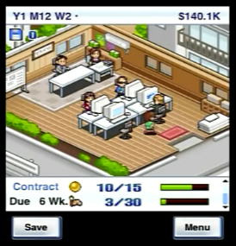
Game dev story
Notes:
At this point I still had a bunch of time to fill. So figured I’d tell my own GameDevStory.
PS: It’s fun game if you haven’t played it: http://itunes.apple.com/us/app/game-dev-story/id396085661?mt=8

Slide 8
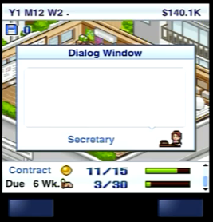

Notes:
So you may know that at Insomniac we’re working on a bunch of new stuff. (If you want to keep up with it, follow @insomniacgames on Twitter)

Slide 9
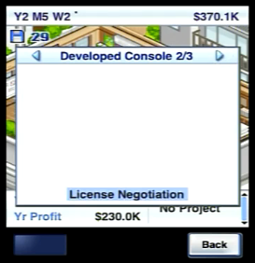
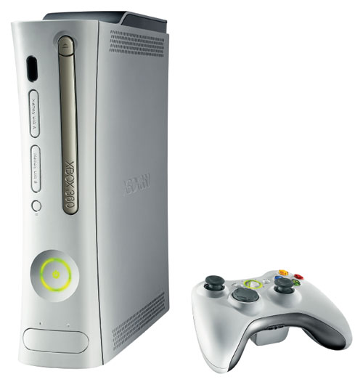

Notes:
We’re going cross-platform, right? So that means big changes for us in the Core (Engine) group.
And we’ve started working on a new game with a new publisher.
And we’ve announced two more games coming out soon.
And we’re making all these changes in the middle of a console cycle.
And more than that, we’re rethinking how we do things and what’s important to us as a team.

Slide 10
Lots of big changes. What are you going to do?
Notes:
It’s a challenge. It’s been a challenge for the whole Core team. We’ve had to adapt rapidly and really figure out what we’re doing quickly.

Slide 11
Shared my personal vision with team.
Notes:
So a couple weeks before this talk, I took stock of where I was and shared my personal vision with the team. Why is this work that we are doing important *to me*?
And that’s where this presentation comes from.

Slide 12
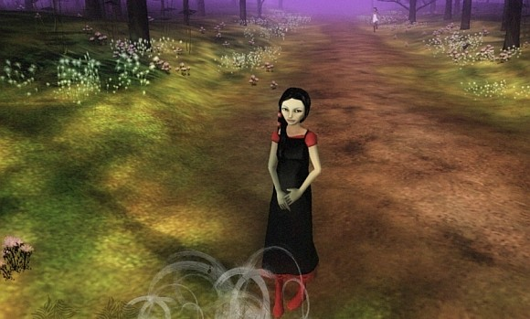
The Path
Notes:
This is about my own personal path.
PS: Check out The Path http://tale-of-tales.com/ThePath/
I couldn’t get it to work on my PC, but it seems pretty cool.

Slide 13
Why?
Notes:
Why do I do what I do?
Why do I care?
Why do I get up in the morning?
Why?

Slide 14
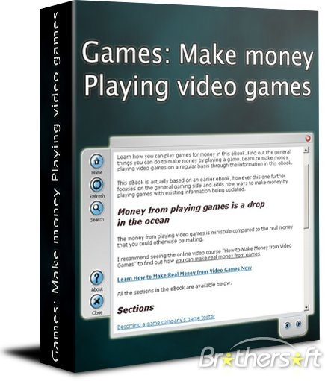

For the money?

Slide 15
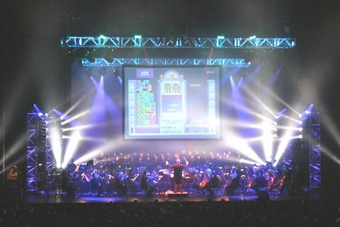
For the fame?
Notes:
PS: This is Video Games Live
Check it: http://www.youtube.com/watch?v=JVHGy9XEF9I

Slide 16

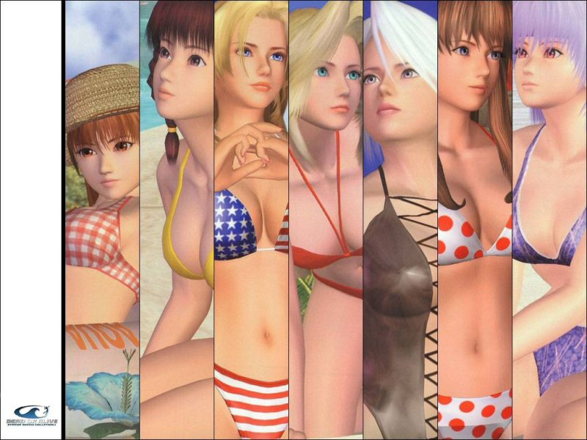
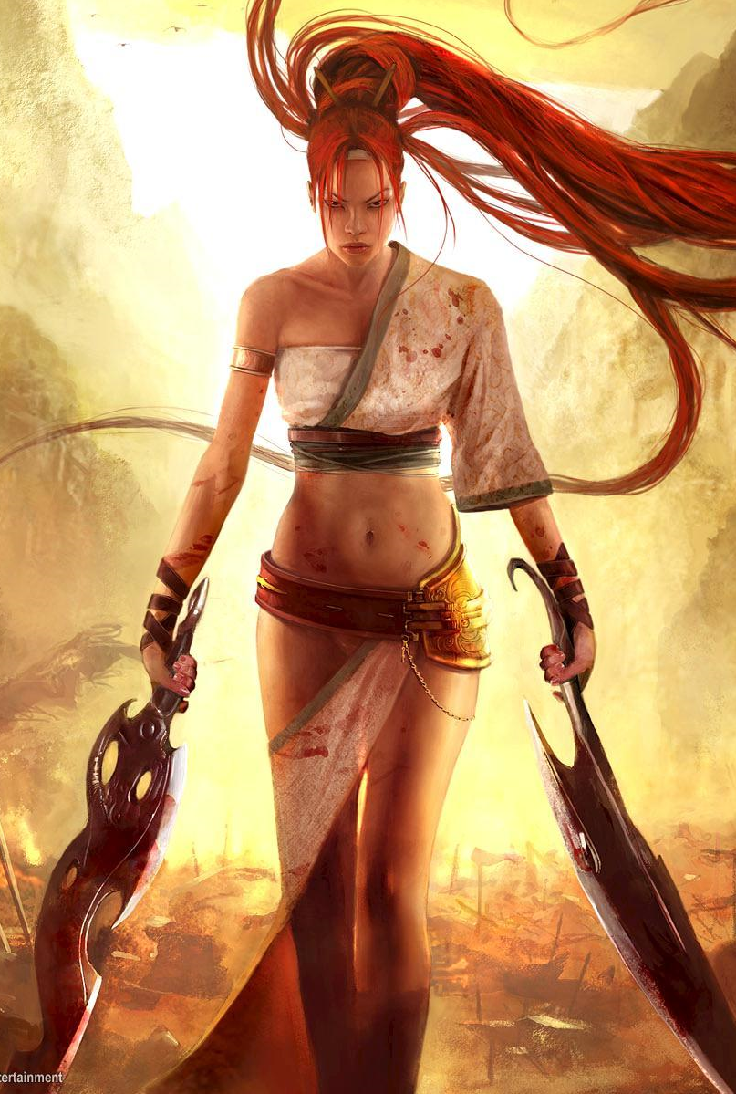
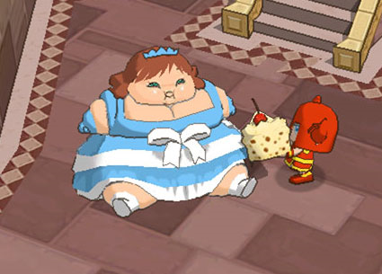
For the girls?
Notes:
Oh, yeah. Too bad Ms. Pac-Man already has a man.

Slide 17
Creation Ego?

Slide 18









Creation Ego?
Notes:
(No offense to Sid Meier. Just the best example.)

Slide 19

Mike Acton Presents: Mike Acton’s Vision of The Engine of The Future Presented by Mike Acton
Maybe a little…
Notes:
Hey look! I have my own muppet. The Community team at Insomniac made that for an internal presentation. I have it on my desk. It’s damn cool.

Slide 20
Because I believe…

Slide 21
Games are important.
Notes:
I believe this deeply. They are an important part of who we are as people and as part of our culture.

Slide 22

Imagine a world without games.
Notes:
It would suck.

Slide 23
Games make a difference.

Slide 24
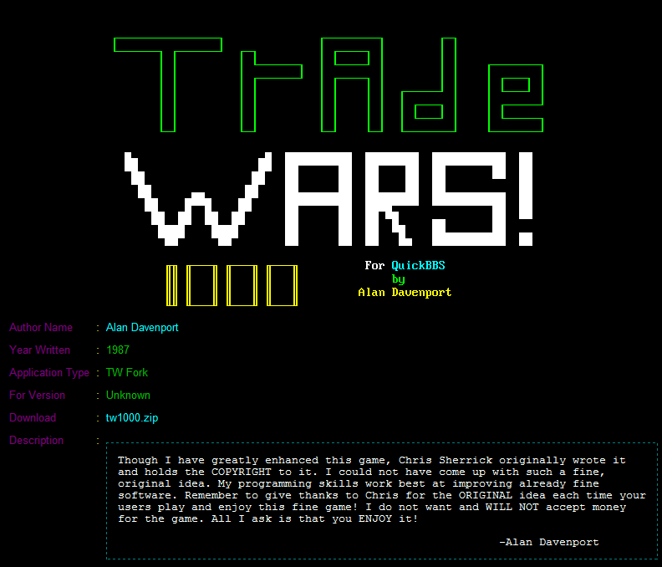
Notes:
Seriously. To this very day I work out my route between places based on some concept of number of moves and try to organize things in a loop where I can manage the resources I need: Home -> Coffee -> Work -> Gas -> Home

Slide 25


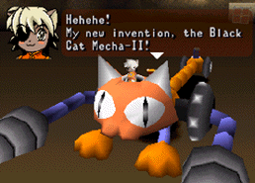
Notes:
My daughter and I played this game for a year. Together, almost every night. It’s a part of our shared history now. And some really fond memories.

Slide 26
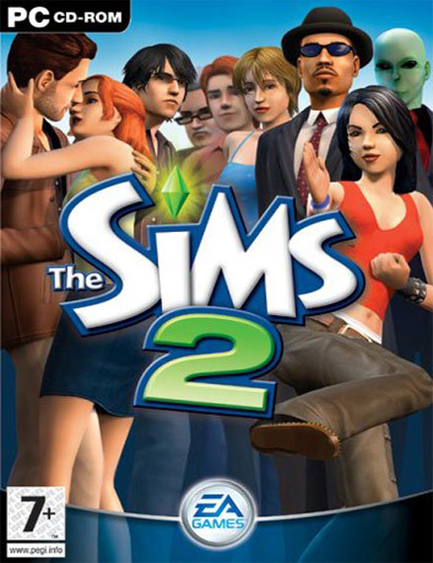
Notes:
My daughter has put THOUSANDS of hours into the Sims. *This* is what she’s going to think back on fondly when she’s my age.

Slide 27
Games are art

Slide 28
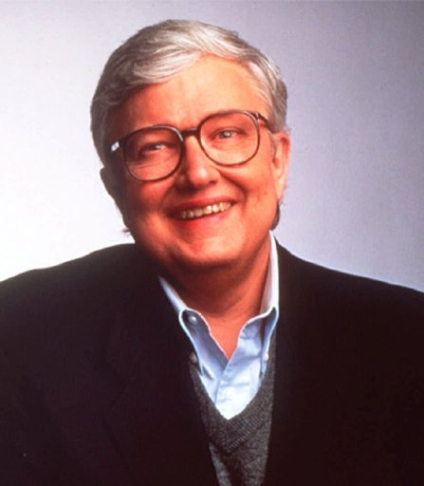
Games are not art!
Notes:
Right so Roger Ebert and a bunch of other people say “Games are not art.”

Slide 29

Full of Shit*
*About video games
Notes:
They are wrong.
Not *all* games are art of course. Just like not all movies or books or paintings or whatever. But they are at least as much *potentially art* as anything else.

Slide 30
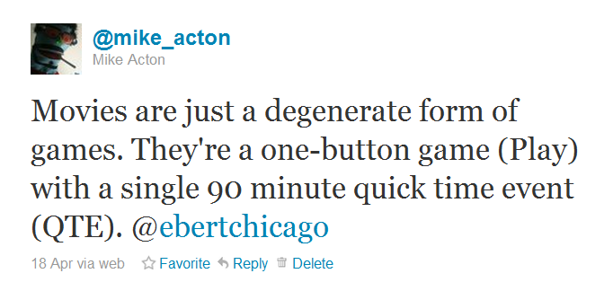
Notes:
Suck it.

Slide 31
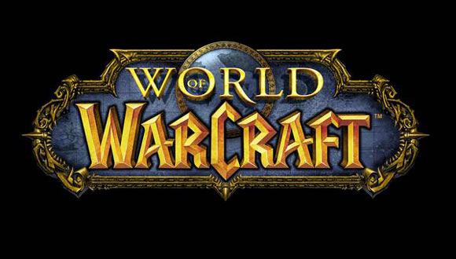
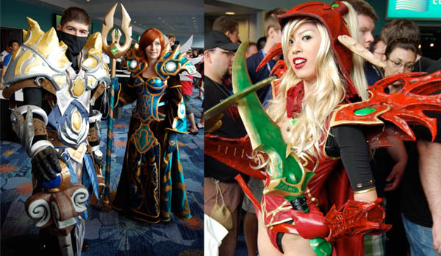
Participatory Fantasy
Notes:
Games let people participate in their own (or others) fantasies.
Damn, these costumes are impressive.
PS: You might want to check this out too - http://www.insomniacgames.com/tech/articles/1107/files/fantasy_of_the_familiar.ppt

Slide 32
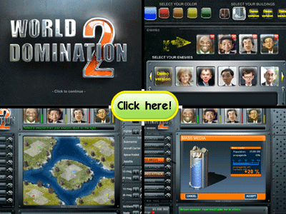
Augmented Dreams
Notes:
Games are a way to augment your own dreams. Like World Domination.

Slide 33
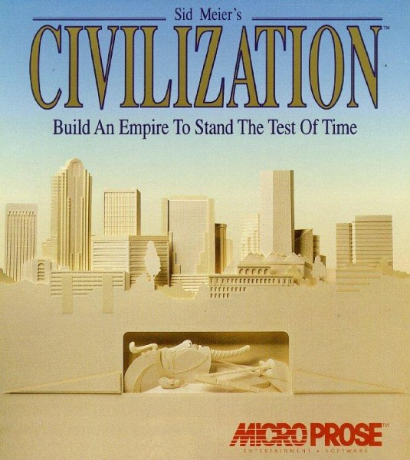
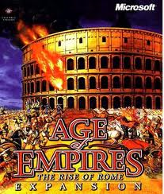
Augmented Dreams
Notes:
Or creating a Civilization in your image. Or building an Empire.

Slide 34
Augmented Dreams
Other dreams?
Notes:
You may have dreams that don’t involve taking over the world. I’m pretty simple that way though.

Slide 35
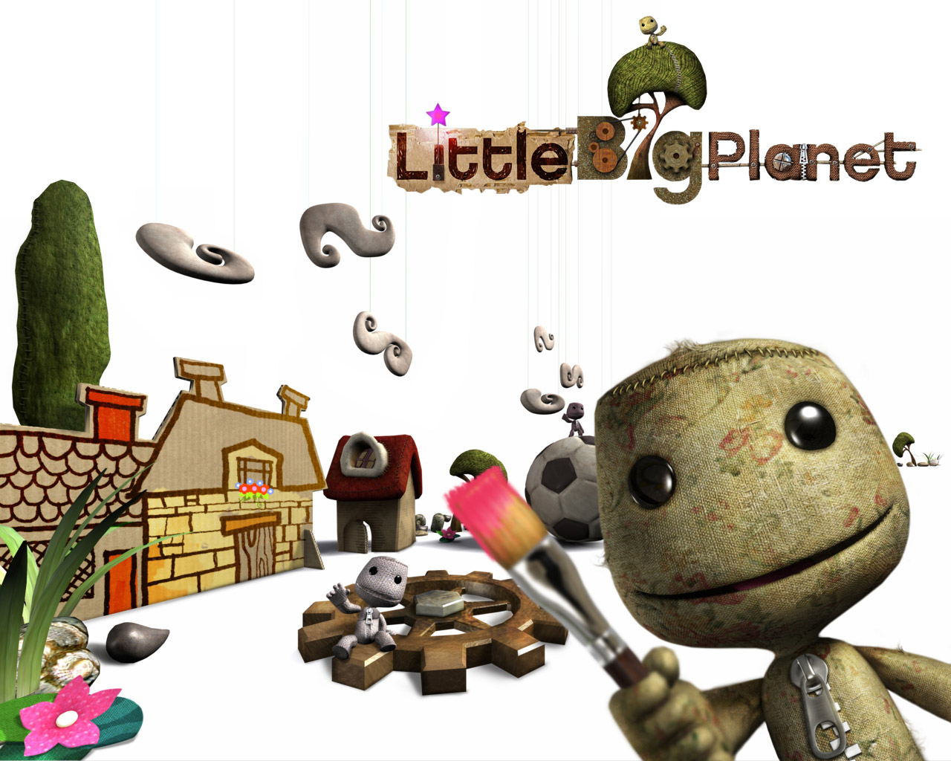
Interactive Creativity
Notes:
Games are a way of expressing your creativity. Little Big Planet – Look at how much crazy stuff people have done for this!
For instance, check what these guys did: http://www.teamkaizengames.com/kblog/kfbb-did-a-cool-piece-on-us/
You can find Josh here: http://twitter.com/#!/ZookeyTK

Slide 36
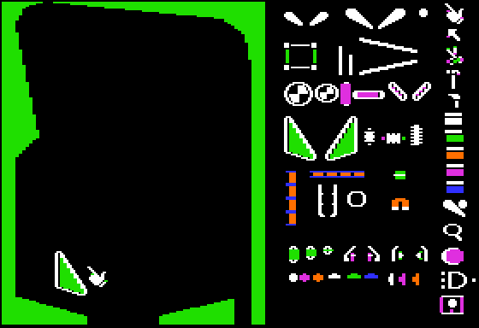
Interactive Creativity
Pinball Construction Set (1983)
Notes:
Oh, damn. This was *so* awesome.
And Bill Budge is on Twitter too: http://twitter.com/#!/billb

Slide 37
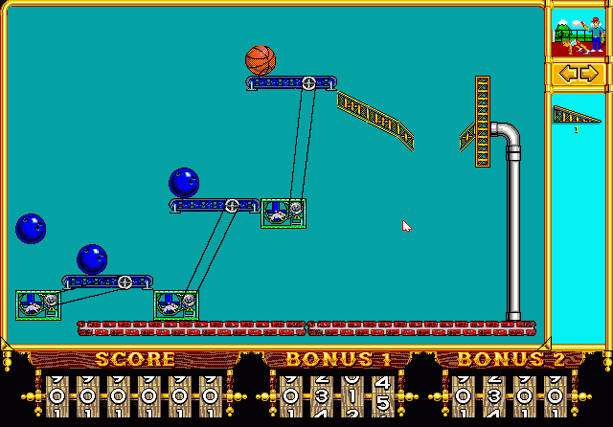
Interactive Creativity
The Incredible Machine (1992)
Notes:
Crazy creations!

Slide 38

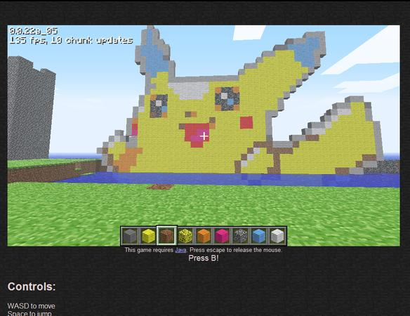
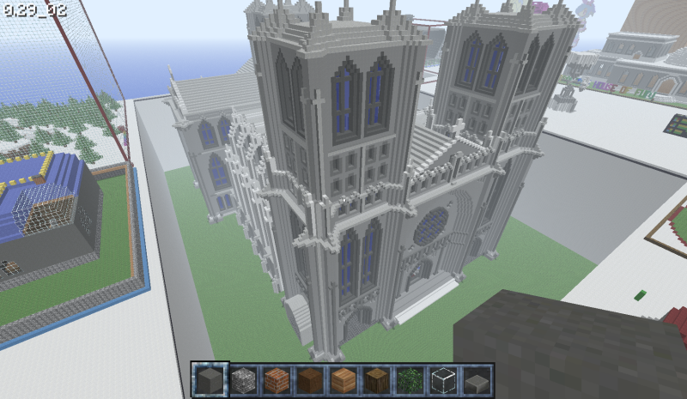
Interactive Creativity
Notes:
OMG. Minecraft is nuts. Productivity = 0.
PS: Carl Glave on our team here just gushed about it recently: http://www.insomniacgames.com/research_dev/articles/2010/152558667

Slide 39
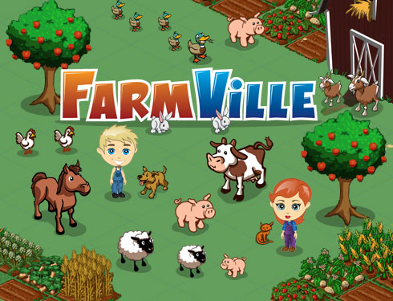
Notes:
Games can also just be an OCD release.

Slide 40
Business vs. Art
Notes:
But whenever we talk art, someone has to jump in with the whole “It’s just big business” line.
As an aside (can I have an aside in a presentation that’s pretty much all an aside?) – I hate it when “Indies” go on about how “we” suck because we’re “just in it for the money” and how they’re just “in it for love” – whatever, you fuckers – If I didn’t love this, I wouldn’t be doing it, either. PS: Here’s a ← HUG →

Slide 41
Innovation != Sales
Don’t get hung up…
Notes:
But when talking about “The Art of Games” it’s easy to get caught up in the argument that innovation isn’t rewarded in the marketplace.

Slide 42
Innovation != Sales
(Radical)
Notes:
And there *is* some truth to that. But usually it’s *radical* innovation that isn’t as successful in terms of sales.

Slide 43
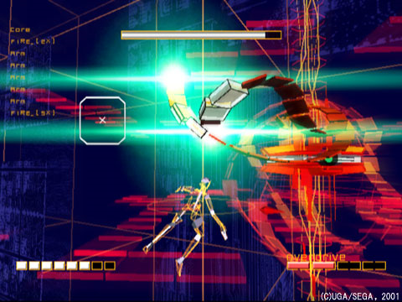
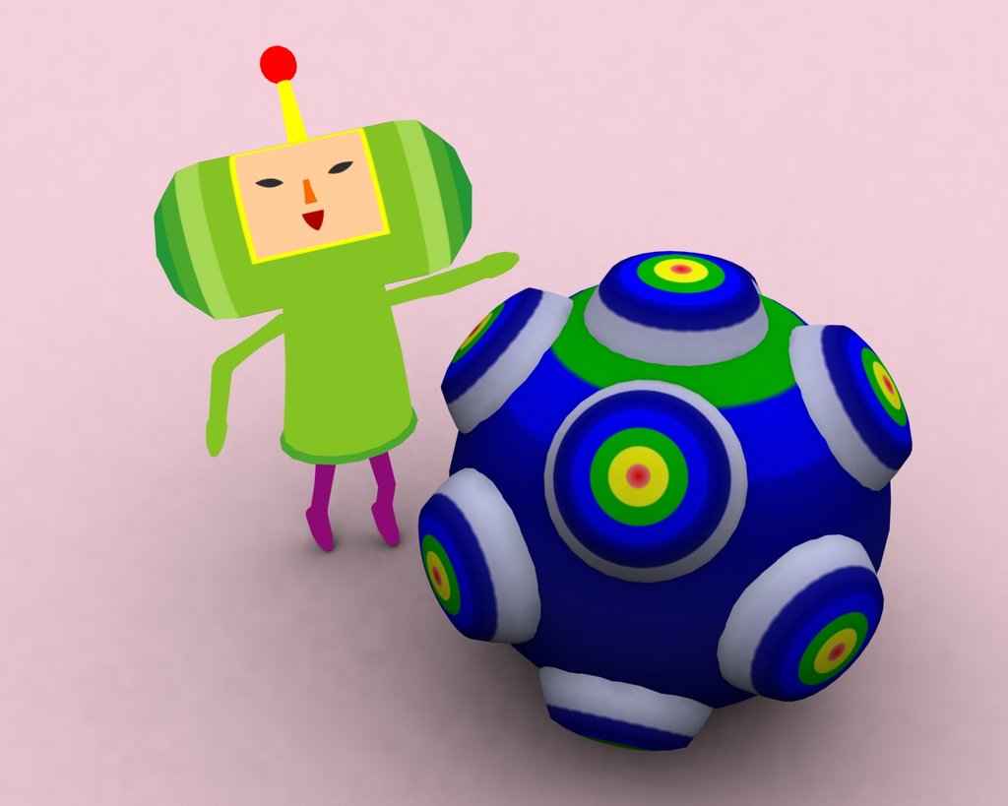
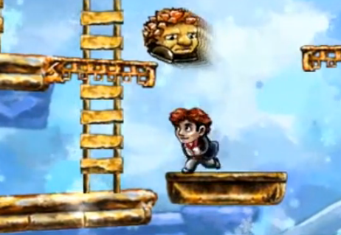
Rez
Katamari Damacy
Braid
Notes:
Of course, that doesn’t mean it’s not important. Or successful. One could hardly argue the real success of these titles. Though sales aren’t in the same category as some of the less “innovative” titles.

Slide 44
Are we short-sighted?
Notes:
So a lot of people don’t want to make radical design leaps. Thinking it will alienate them from their players. So does that lead to short-sightedness?

Slide 45
Are we short-sighted?
Only sometimes. Mostly impatient.
Notes:
Sure, a bit. But mostly it’s because people forget that they have *forever* to innovate. You don’t have to do it all at once. You don’t need to feel like you have to change everything now or *nothing at all* - that’s short-sighted. And kinda lame.

Slide 46
Innovation by degrees
(Many games theory)
Notes:
You have a lot of games in front of you. Between now and some future game, you can make a massive amount of innovation.

Slide 47

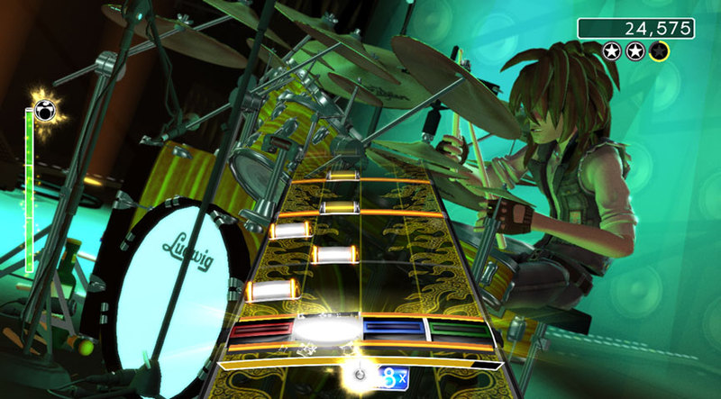
Parappa the Rapper
Rock Band
Notes:
Look at Rock Band. I don’t think it would have been possible for it to be the success it has been without Parappa (and all the stuff in between), personally. Perhaps you have a different opinion?

Slide 48
Discover unknown uses.
Notes:
Another advantage to not trying to do everything at once is that you can learn during the process. It’s inevitable that when you put something, even a small thing, in front of some real users that you’re going to discover some unknown uses. Machinima is a great example.

Slide 49
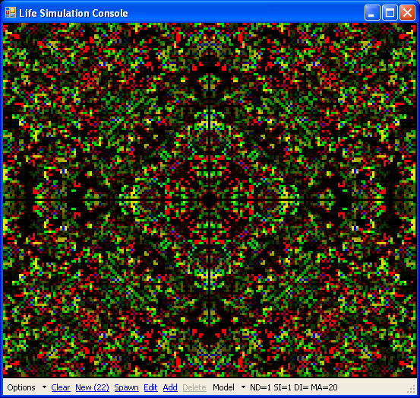
Notes:
It’s like Conway's Game of Life. You never know what cool (or crappy) patterns you’re going to get until you really just try it.

Slide 50
I believe in games as pop
Notes:
I’m a huge fan of pop entertainment. I believe it plays an important role in society. I believe it serves a role in reflecting us as a culture. It’s easy to be dismissive of pop, of course. Especially for fans of things things (music, film, games, whatever) that are perhaps less popular, but in their estimation “better” – But that doesn’t diminish the value of pop.
What I’m not saying is that *all* games are pop. But largely it is the world that I live in and I love it.

Slide 51
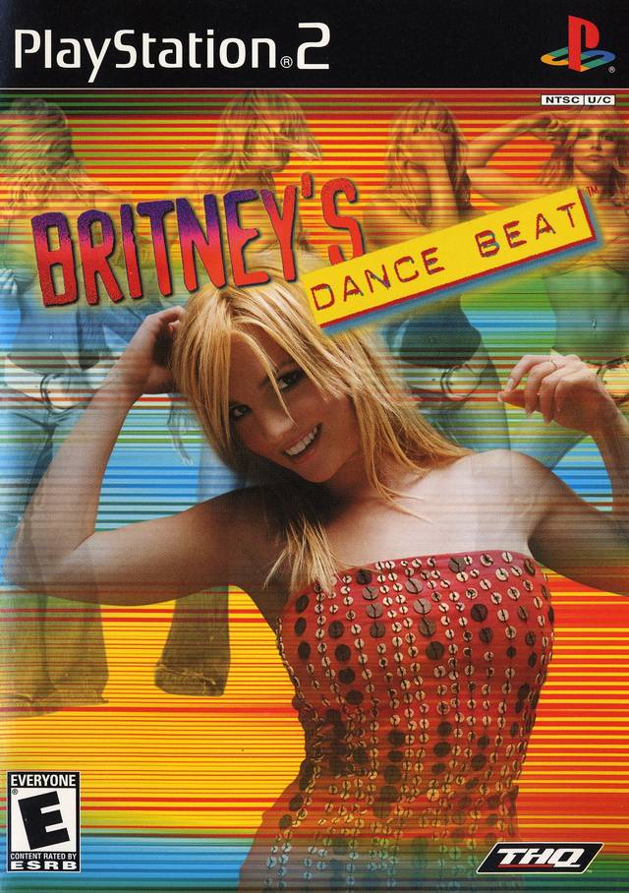
Notes:
It’s like Britney. I’m a huge fan. Or Lada Gaga or Eminem. They are reflecting things about us and tell us a lot about ourselves. Sometimes it’s pretty. Sometimes it’s really not. But it’s always interesting. And it doesn’t hurt that you can dance to it.

Slide 52
Reflect the world and the world will surprise you.
Notes:
When you try to reflect the world, you will find some amazing things. People are way more interesting than you think. Even teenagers.

Slide 53
Business + Art
Notes:
Pop is really about the marriage of business and art. It’s both those things. And the business itself, of discovering what’s important and valuable to an audience and how the world and culture are changing, can itself be an art.

Slide 54

The Art of Pop
Production value matters…
Marketing matters…
Notes:
When I talk about pop, the things that help ‘sell’ it matter for sure. Like pure production value and marketing. But…

Slide 55
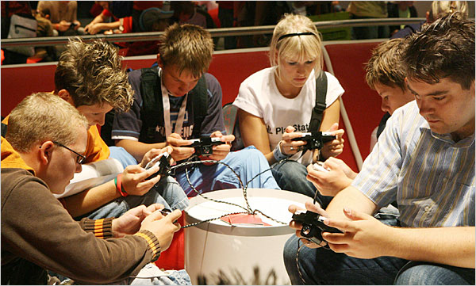
Players Matter.
Notes:
But the main thing that distinguishes it is that the players matter (or listeners, or watchers, depending on the medium) – You are building something for others in addition to yourself. And understanding their perspective and their role in creation is why it’s so very special.

Slide 56
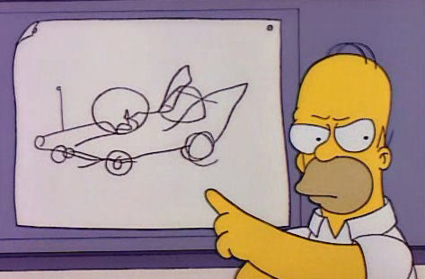

Notes:
That doesn’t mean (obviously) that you just listen to whatever they say and do that. You get craptastic results that way.

Slide 57

Notes:
And sometimes haters just wanna hate. You have to be careful of that too.

Slide 58

Notes:
There are definitely dangers lurking in development though…

Slide 59
Cult of Productivity
Notes:
It’s easy to forget why we’re doing this. It’s easy to get lost in the day-to-day of tasks, bugs and urgent issues. It’s easy to feel like you’re making progress just because you’re doing *something* - Of course the work is necessary, but it’s not sufficient.

Slide 60
Small company vs. big company
Notes:
One example is big companies. Big developers. Big publishers. Whatever. It’s easy to get caught up in the making and shipping of games each year. And the sales and the marketing. And nonsense on the internet. And metacritic. It’s easy to forget what our responsibilities to the art.
We’re here because we built on what others did before us. We’re absolutely responsible for returning that value to those that follow. How you do that is up to you. It could be gameplay innovation or technical research or visual experimentation.
Some people feel it’s “the indies” that need to push the boundaries because that’s what their primary motivation is. Sometimes that’s true. However, it’s the big boys that have both the resources and responsibility to give back the most.

Slide 61
Individual & Professional
Notes:
The same holds true for us as individuals and professionals. The more we’ve taken, the more we need to give back. The more we have the resources as individuals to research and innovate and experiment, the more we have the responsibility to.

Slide 62
Games are a playground
Notes:
Games are also a safe place for a huge variety of research.

Slide 63
Playground for technology
Notes:
We do, obviously, get to play with a lot of technology. The Cell processor certainly comes to mind for me personally. It has been a great opportunity to try out new ideas and experiment with concurrent processing, etc. in real practice, under real production conditions.

Slide 64
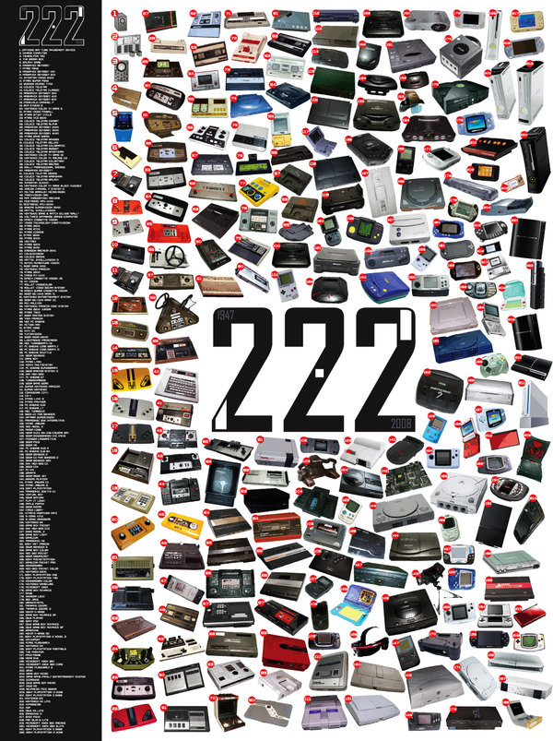
http://greatnscott.deviantart.com/art/222-Console-History-99487643
Notes:
But there’s been a crapload of tech over the years in consoles. You should go check out this guy’s image of 222 consoles: http://greatnscott.deviantart.com/art/222-Console-History-99487643
From playing with CDs and DVDs and Blurays when they were all still new. To tons of different CPUs and GPUs and approaches. It’s always an amazing ride.

Slide 65
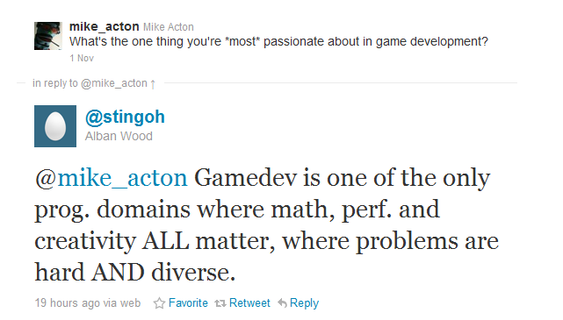
Notes:
I agree with Alban that these all matter. But I also think a lot of it is because games attract a lot people who are interested in hard and diverse problems in the first place. I’m sure there are probably other industries that would say the same thing. But for the purposes of this, let’s just say I don’t care about them. :)

Slide 66
Playground for ideas
Notes:
Games are also a place where we can experiment with a lot of different ideas from other areas of study and see how they work.

Slide 67
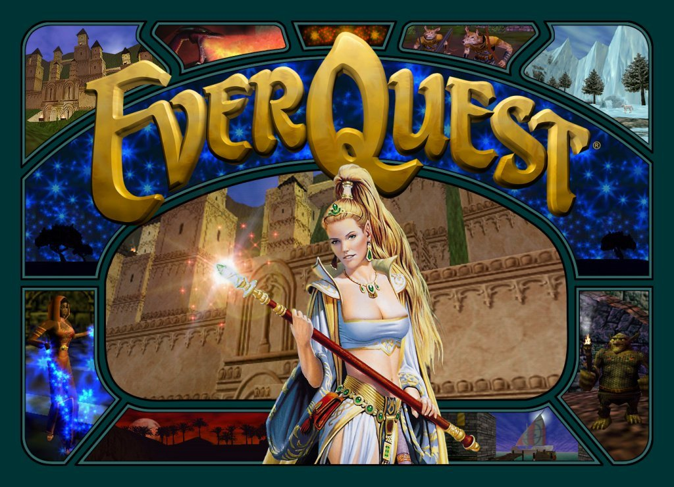
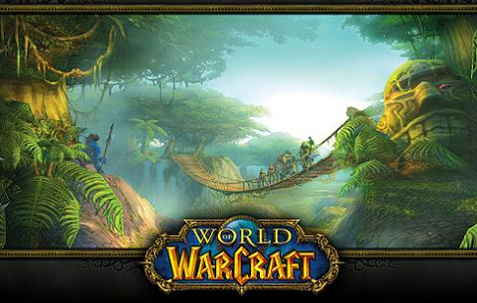
Business, Management and Economics
Notes:
People have learned a lot of really interesting lessons about economies and business behavior from the big MMORPGs like EQ and WoW.

Slide 68
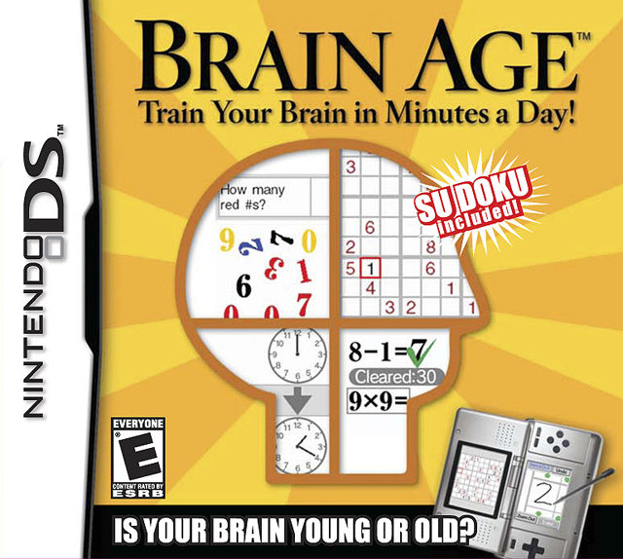
Educational Studies
Notes:
Or experiment with how to engage people’s brains a bit more in a fun way.

Slide 69
Other playgrounds for games
The Arts
Human Development
Cultural Studies
Labor Studies
Social Theory, Social Structure and Change
Notes:
I can hardly think of an area of study that couldn’t find an application in games. No matter what you’re interested in, there’s a way to bring that passion into games.

Slide 70
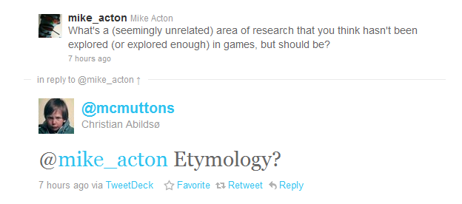
Notes:
I don’t know how we could apply etymology more in games, but I’m sure it’s possible. When I saw this, I also thought entymology (which is what I originally thought he wrote.) Both I’m sure can be applied to AI somehow in really interesting ways.

Slide 71
Why does it matter what I believe?
Okay, but…
Notes:
It probably doesn’t. But since I’m here…

Slide 72
Defined me and what I do.
Notes:
Without games I certainly wouldn’t be who I am today.

Slide 73
Playing
Trading
Programming
Making
Notes:
Starting with playing games. Which lead to trading among my friends and becoming a programmer. Ultimately, which brought me back to making games.

Slide 74
Inspired me
Notes:
But also games, and the industry of development, have inspired me to do the things that I do today.

Slide 75
“So we need some standardization for data interchange among development tools and products. The more developers that adopt a standard, the better for all of us and our customers.”
-- Jerry Morrison, EA IFF 85
Notes:
EA’s IFF85 document was the first time I had ever seen a game company document an idea and share it for the explicit reason of making things better for everyone. I’m sure it wasn’t the first time, but that’s not important. It was the first time for me.

Slide 76

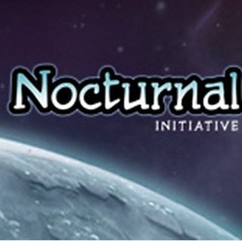
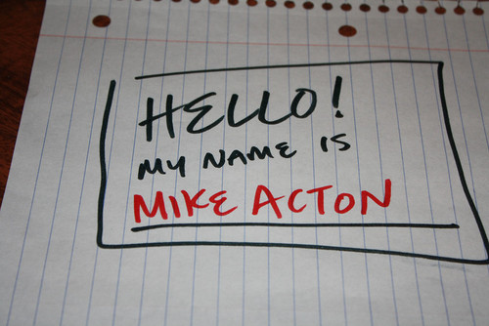
Notes:
And for me personally, I can point to that one document and say that it is absolutely because of how that inspired me that I do some of the things I do today. Like cellperformance.com or our Insomniac R&D pages and Nocturnal Initiative. Or other presentations (like this one!)

Slide 77
"Simple things should be simple and complex things should be possible."
-- Alan Kay
Notes:
Interestingly, that document was also the first place I had ever seen this quote by Alan Kay. Which I certainly still refer to today.

Slide 78
Color all of my choices every single day
Notes:
All of these things make a difference to me. Are important to me. And have profoundly affected who I am and what I do every day.

Slide 79
Why do I do this?
Games are important
Games make a difference
…as art
…as pop
…as a playground
Games inspire

Slide 80

What gets in the way?
Haters
Our impatience
Cult of productivity
Forgetting why we’re here

Slide 81
How?
Notes:
How do we use that? How do we make a difference?

Slide 82
The power of one person
Notes:
Everyone has the power to make a difference.

Slide 83
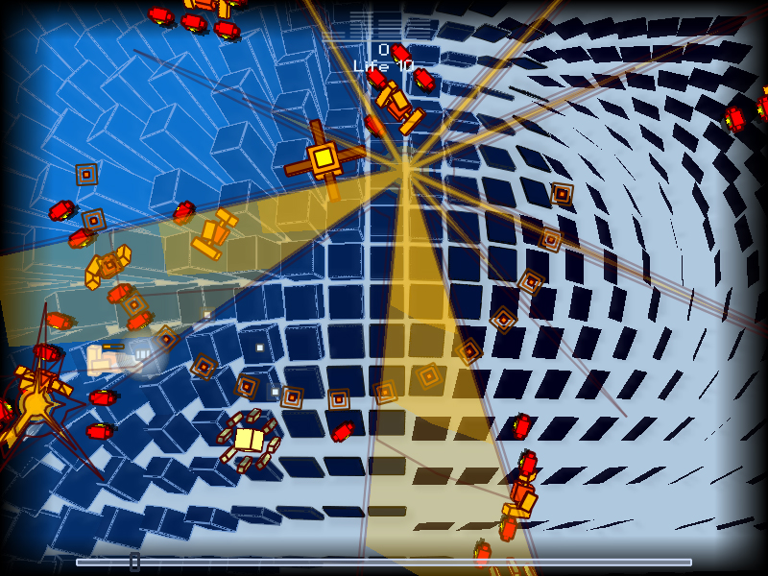
Everyday Shooter, Jonathan Mak
Notes:
Some people use that to show the world what they can do all by themselves. And that definitely has value. PS: You should play this game. I’m a fan.

Slide 84
Impact on a team
Notes:
But for most of us, it’s about how we can make an impact as part of a bigger (and for some, a quite overwhelmingly large) team.

Slide 85

Our job is what we make it.
Notes:
This is one of the most important lessons I can share. It’s not always easy. But you can’t get caught up in only looking at what’s put immediately in front of you. It’s each of our own responsibility to *figure out* how we can make the biggest difference in whatever we are doing. And there is always room for that.

Slide 86
Prediction: 50% - 5 years 100% - 10 years
Notes:
Here’s what I predict: Write your job description down. What are the specific problems that you work on day-to-day? What are the specific challenges you face?
In 5 years, for 50% of you that job, as described, will no longer exist.
In 10 years, for 100% of you that job, as described, will no longer exist.
Your job will only be superficially similar, if it’s similar at all. The world changes fast. We all need to keep up and change with it.

Slide 87
Growth (2x)
Notes:
I have this goal. For me personally and for my team. I want us all to grow to be twice as good at our jobs each year as we were the year before. What that *means* for each person may be different. But the sentiment is the same. If you don’t grow by leaps *constantly* you will fall behind. And growing and learning is what we exist for. It’s what excites us most as people.

Slide 88
Building an engine
Notes:
I should actually probably talk a little bit about building a Game Engine. How do I bring all of these ideas to my own work?

Slide 89

Vehicle for passion
Notes:
I see a Game Engine as a vehicle for passion. For the passions of those that make the engine, for those that use it directly to create a game, and indirectly for the players as well.

Slide 90
Reflect developers’ vision
Notes:
The purpose of an engine is to reflect and enable the developer’s vision. Provide the necessary functionality to accomplish what they want to accomplish. Of course, the practice of it is a lot more complex. It should also reflect the vision of the developers of the engine as well. The challenge is to find a way to do both, or balance them. And resolve the practical issues of development (like resource allocation, performance, development costs, etc.)

Slide 91
Technology-driven industry cycle
Notes:
I think all technology driven industries follow a similar kind of cycle…

Slide 92
Experimental
Accepted
Ubiquitous
Sophisticated
Notes:
They start off experimental. Some hacker throws a bunch of stuff together and comes up with something new and cool. Shows it off. People get excited.
At some point it’s not experimental anymore. It’s accepted and an industry starts to build up around the idea.
Over time, the process becomes much more rich and sophisticated. Brand new specialties arise. The complexity of building a project becomes enormous by comparison with the early days. Many, many more people involved.
However, at some point tools evolve. Work that required a lot of custom work by specialists becomes commodity. Straightforward enough for anyone to do to a useful degree. When those tools evolve far enough, the process becomes much more experimental again. Where many fewer people can make a significant product.
e.g. Movies. Lots of tools now for experimenters. People can pull of very sophisticated effects, compositing, editing, filming, etc. at home and post on to youtube. We’ve seen a lot of cool stuff.
Games will see the same development. Already started, actually.
While there’s always room for the big, sophisticated productions, the amount that can be accomplished by a single person with the right tools is growing rapidly.

Slide 93
The start and the goal
Experimental
Accepted
Ubiquitous
Sophisticated
Notes:
The goal is to get back to experimental. And then build on that to solve *brand new* problems.

Slide 94
The Programmer Bias
Notes:
What gets in our way though? Our biases.
Programmer bias is strong in our industry. Which is the idea that only a programmer can do something. That a task is so sophisticated that it must be programmed by an expert, or it simply cannot be done.
Which, of course, is bunk.
That may be true today for many things. But it gets in our way when we believe that it *must* be true.

Slide 95
Negativity Bias
Notes:
Also, we do have a tendency to be over-critical and negative. We don’t always let ideas play out first. We don’t assume first that it *can* be done.
We are cynics by nature.
But we must not forget that it’s optimism, a totally unfounded belief that something new can be done, that changes things.
PS: Since I gave this presentation, I wrote a bit more detail on my own biases (including these two) here: http://macton.posterous.com/personal-biases

Slide 96
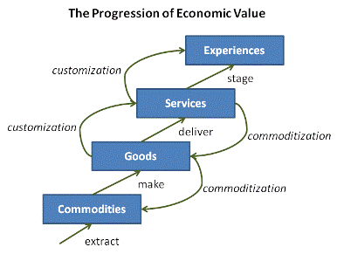
Joseph Pine, The Experience Economy
Notes:
Joseph Pine wrote about the Progression of Economic Value, which also applies to Game Engine development.

Slide 97
(For developers)
Joseph Pine, The Experience Economy
Notes:
A game engine is an economic engine for developers. It’s built on the time and energy resources of the team making the game and transforms that into the value for the player and the vision of the production team.

Slide 98
(For developers)
In hardware
Joseph Pine, The Experience Economy
Notes:
We could build custom hardware for every video game. That’s the basic commodity. (And certainly, that’s how things started.)

Slide 99
(For developers)
Programmers
Joseph Pine, The Experience Economy
Notes:
But as the hardware itself is commoditized, programmers customize it to make the games.

Slide 100
(For developers)
Basic
Tools
Joseph Pine, The Experience Economy
Notes:
But then, as what the programmers are doing is commoditized, basic tools come on line which can be used to customize the game.

Slide 101
(For developers)
Make it happen!
Joseph Pine, The Experience Economy
Notes:
Even further, as that custom work of the tools is commoditized, fewer people can concentrate on builder more custom experiences (or individual ones, even) by leveraging the work before.
Obviously this doesn’t all happen together. Some parts of game development are very far along in this progression. But clearly, many parts a lagging if the average development cost is any indication.

Slide 102
Reflect players’ choices
Notes:
Games, fundamentally, should reflect player’s choices. Engines need to enable that.

Slide 103
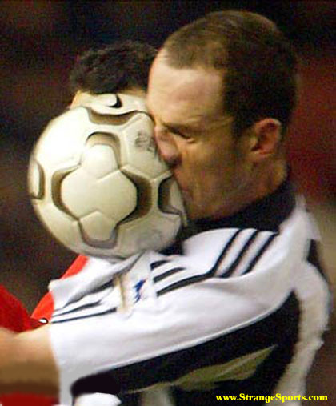
Realtime = Reflect player choice
Notes:
Video games are about realtime interaction. The reason to do that is to reflect what the player does. It’s the main value of the medium!

Slide 104


Notes:
Aside: It really pisses me off when I meet game developers who really (secretly or not) just want to make movies. Go make movies then. Games are a different medium. While they can share things (like having a story) they are fundamentally different.
Video games are NOT an evolution of movies or TV!
Video games are an evolution of other games. People have played games as long as there have been people. Whatever technology existed, people figured out a way to play games with it. The fact that now we play them on the TV or on the computer, or iPad or whatever doesn’t change that fact. Games are games.
Movies and TV are about storytelling. That’s totally fine.
But while a game *can* tell a story, if that’s all it does, it’s not a game.

Slide 105
Post
Shaders
Camera
Environment
How else can you reflect players’ choices?
Notes:
We still have a long way to go to figure all the ways we can reflect the players’ choices in games.
We still largely model after a static world that *cannot* reflect the player.
e.g. We model a static building, because in real life, it must be static. So that’s familiar and we understand it.
But that building was made with some function in mind. For example, it might have a focal point (stage) and architecturally it’s designed to draw your eye there. But in games we can potentially change that focal point based on the choices the player has made and affect the whole architecture.
Lot’s of things left to experiment with. Endless!

Slide 106

Believeability
Notes:
First off, I don’t like argument for “realism” in games. Realism is a fool’s errand. And closes a lot of interesting possibilities to boot.
Believability, however, is crucial.

Slide 107
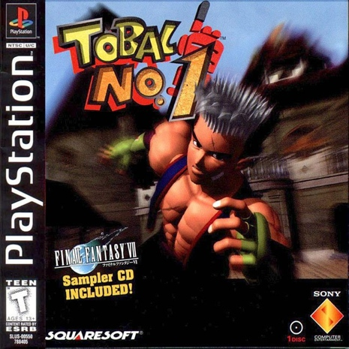
Notes:
Tobal No. 1 was a great example. Not realistic at all. But the developers did a great job of making it *believable* - in particular, the grappling and animations matched the style of the art and the world. Very few titles have done as good a job since at that, IMO.

Slide 108
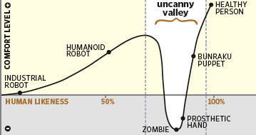
We are here
Notes:
And you can’t talk about believability without talking about the Uncanny Valley. Basically, we’re close to the bottom right now (for the kind of big budgety adventure or FPS type stuff.) Everything is just a little bit creepy and unnatural. And it’s actually getting worse still. Most notably as character models and shaders improve.
An engine needs to be balanced. Also have to focus on the things that will bring you out of this valley and make the final work more believable. Animation is an example, for sure. But it’s not the only thing.

Slide 109
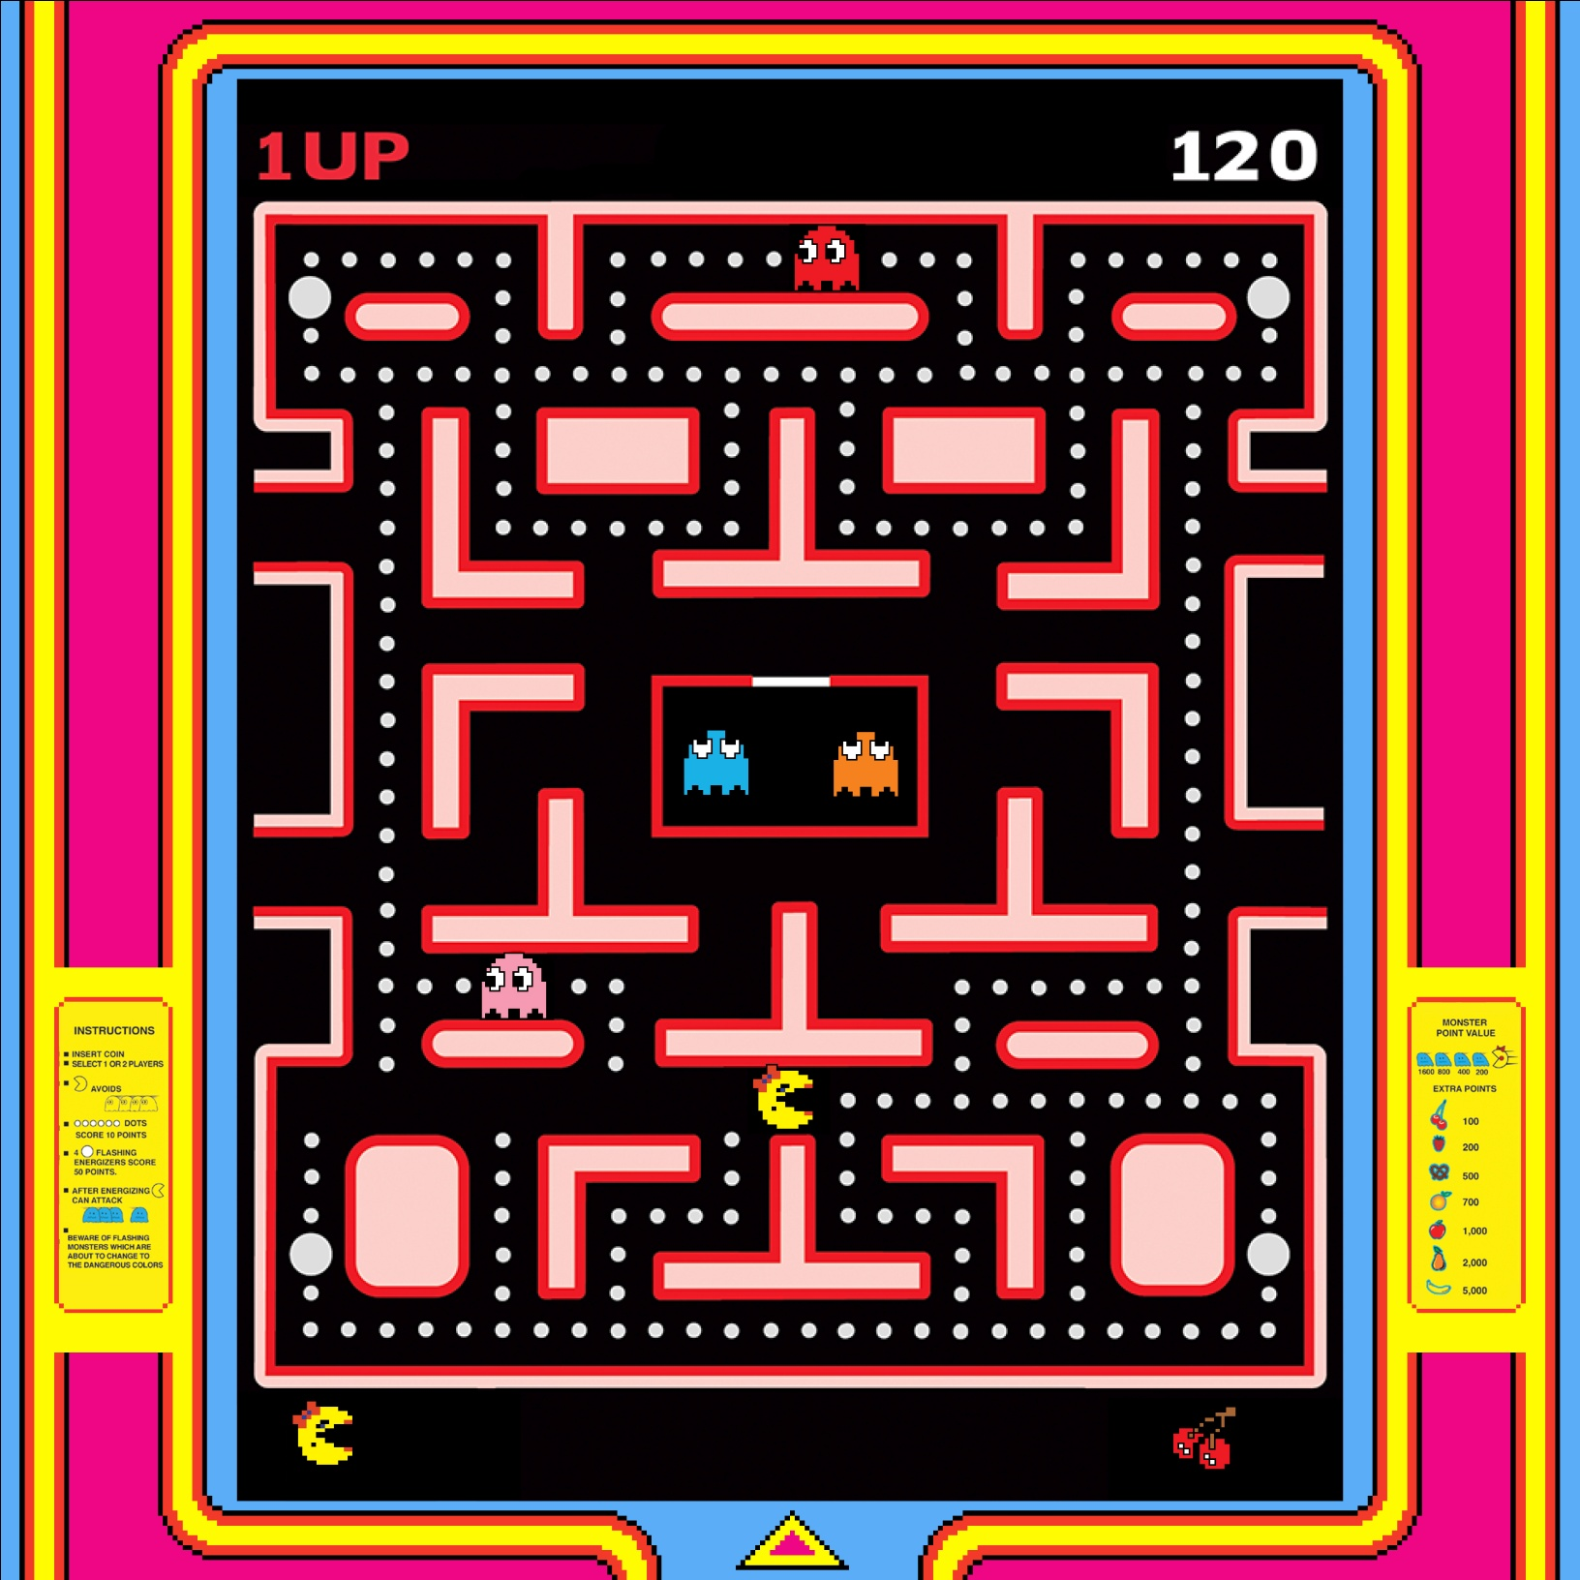
Notes:
It’s not *just* about the high-res human games, either. Ms Pacman is believable. I accept her in her little world with these ghosts and fruits. Of course, it’s largely because it’s more abstract art that it’s easier to accomplish that. But it’s still a consideration in any title.

Slide 110

Usability
Notes:
This is a huge (and obvious) lesson. If people can’t use an engine effectively, it doesn’t matter how good it is under there, no one will ever see it.
I wrote a bit about my thoughts my personal approach/thoughts on usability. A presentation which I have yet to finish, but the basics are there: http://macton.posterous.com/unfinished-usability-is-not-random

Slide 111
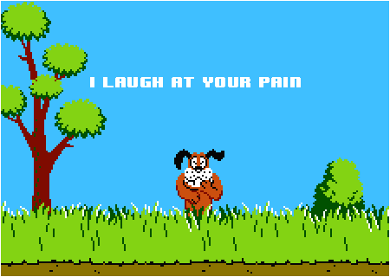
Notes:
It’s easy to blame the users. Don’t.

Slide 112
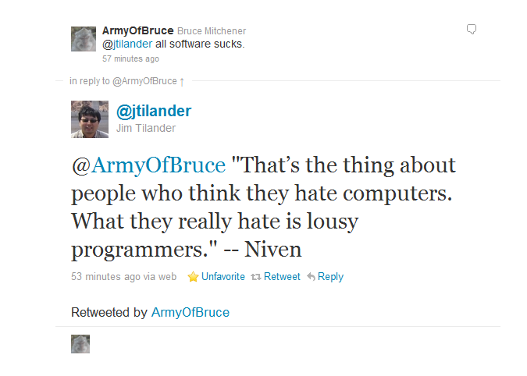

Slide 113
Usability cart stories
Notes:
One thing that we’ve done that’s been pretty effective is “usability cart stories” – we have a machine on a cart which we drag over to different people’s desks. We let them work with the engine for a couple of hours or whatever and then write a story about what we learned from watching them and share that with the team. Inevitably there’s a lot to learn. No matter how many times you do it.

Slide 114

Feedback
Notes:
Good feedback is critical to any project.

Slide 115

Notes:
Personally, while I feel that I’ve always asked for feedback and criticism, I’ve not been awesome about the rest of the feedback cycle. In particular with making sure people know that I appreciate their feedback and see what I’ve done based on it (revisited with them.)

Slide 116

Notes:
I thought I’d mention that I’ve been using Rypple internally for gathering feedback and collecting notes.

Slide 117
How do I make a difference?
As an individual
As part of a team
Building an Engine
…reflects developers’ passions
…reflects players’ choices
…through believability, usability
…and feedback

Slide 118
What gets in the way?
Not making the most of our jobs
Programmer and negativity biases
Not focusing on usability
Neglecting the feedback cycle

Slide 119
What?
Notes:
What do I focus on in practice? What do I enjoy? What’s important to me?

Slide 120
Performance
Notes:
I care about performance. Performance is what enables us to do more. Performance is the currency for creative freedom.

Slide 121
“Never underestimate the power of speed.”
-- Eric Schmidt, CEO of Google

Slide 122


Notes:
I know someone’s going to bring this up. Performance doesn’t just mean a faster framerate. It means how you choose to use the performance you have. The only reason this question (60 fps vs. 30 fps) is relevant is because we have had enough performance to make the choice. To many devs, unfortunately, it’s not even a choice. There’s not enough real performance to even consider an alternative to whatever they have.

Slide 123
Hardware
Notes:
I care about hardware. Software doesn’t exist in a vacuum. There is no “abstract software ether.” Decisions have to be made based on the real plarforms that they’re running on. I would hardly make the same choices for software intended to run across all of Google’s servers as I would for software to run on the Gameboy. The whole idea that there is a software solution to any problem *independent* of the hardware it runs on is pure fiction.

Slide 124

Notes:
Most of the time even an extremely superficial understanding of the hardware is enough to make better decisions. Just looking at the cell processor, for example, the PPU there is about 1/10th of the chip. Do you really want all your code on that?

Slide 125

Data
Notes:
I care about data. It’s the only thing that matters. There’s just too much code architecture wankery in the world. And not only are the benefits truly dubious, they often make things much, much worse than is necessary. For performance. For maintenance. For memory. For whatever.

Slide 126

Notes:
The purpose of any program is to transform data from one form to another. That’s all. Nothing else.

Slide 127
Magic
Notes:
I care about Magic.

Slide 128
Value in magic
Notes:
I *believe* in magic. There’s real value in creating something surprising. Or something wonderful that appears to come from no where or nothing.

Slide 129
The magic of the unexpected

Slide 130

Notes:
This is a screenshot of a character hierarchy in Maya. When we saw this, we were very surprised at it’s complexity. In fact, it’s much, much more complex than this since all the math nodes are actually hidden.
But we wanted to see what we could learn from this surprise. We asked the riggers to present to us their process. Of course we learned a ton. But in addition, it really became obvious that they had done something, using very poor tools actually, that could be applied to a lot of different areas. Not just animation.
Which led to some whole new conversations.

Slide 131
The magic of play
Notes:
You have to play. Try stuff out. See how it works. Learn what you can from it.
You can’t just be locked into the way it is now. Or you’ll be obsolete very soon.
So what are some of the things we’ve played with recently…?

Slide 132



Notes:
We’ve looked at webapps a lot for inspiration for our tools. In fact, we’ve been doing a lot more in Flash and Javascript if you can believe it!
I figure this whole web thing probably isn’t a fad. There might be something to it.

Slide 133

Notes:
We’ve also looked to the social media sites for inspiration for our own tools and processes.

Slide 134

Notes:
And, somewhat ironically, the thing we hadn’t looked at enough before: We’re looking at games. We’re looking at how we can use the lessons we’ve learned from games to make making games better.

Slide 135
The magic of failure
Notes:
It’s also important to fail.
It’s important to let people fail.
You must embrace it.
If you’re afraid of failing, you are paralyzed from doing anything actually interesting.
But of course that does mean that you *will* fail…

Slide 136

Notes:
Sometimes spectacularly.
Spawn: The Eternal.
I was on this team. This was not an awesome game. I believe involved on this game would say it was a failure. An awful, awful failure.
The first (and only) time I’ve ever seen the phrase “explosive diarrhea” used in a game review.
But everyone on this team learned a lot from the experience. And we’ve all gone on to do much better and take those lessons with us.

Slide 137
You failed. Try again?
Notes:
You have to *want* to fail. The trick is to do it as quickly (and cheaply) as possible. Then figure out what you learned and try again.

Slide 138
“If you don't fail at least 90 percent of the time, you're not aiming high enough.”
-- Alan Kay

Slide 139
What am I going to focus on?
Performance
Hardware
Data
The unexpected
Play

Slide 140
What gets in the way?
Unoptimizable systems
Not understanding the platform
Not understanding the data
Fear of failure

Slide 141
Asking Questions
Notes:
So these are the questions that I asked myself at the start of this…

Slide 142
Why am I here?

Slide 143
What am I most passionate about?

Slide 144
What drives me?

Slide 145
What’s important to me?

Slide 146
What inspires me?

Slide 147
How do I make a difference?

Slide 148
How can I make a bigger impact?

Slide 149
How can I reflect the world?

Slide 150
How can I reflect the player?

Slide 151
How can I reflect our passions?

Slide 152
How can I overcome my biases?

Slide 153
How can I use feedback better?

Slide 154
Where can I make all new mistakes?

Slide 155
What am I going to focus on?

Slide 156
What else is out there?

Slide 157
How can I use the unexpected?

Slide 158
Is this fun?

Slide 159
What’s the data look like?

Slide 160
Lots of big changes. What are you going to do?

Slide 161
Be a real person
Passions
Better choices
Notes:
I try to use my passions to drive my choices.

Slide 162

Notes:
When I do that right, I’m on fire!

Slide 163

Your turn.
Notes:
How would you answer these questions? How does it affect what you do?
Twitter: @mike_acton
Email: macton@gmail.com

Slide 164
Your turn.
Part 2

Slide 165
Why are you here?

Slide 166
What are you most passionate about?

Slide 167


Slide 168


Slide 169


Slide 170


Slide 171


Slide 172


Slide 173


Slide 174


Slide 175


Slide 176


Slide 177


Slide 178


Slide 179
What gets in your way?

Slide 180


Slide 181


Slide 182


Slide 183


Slide 184


Slide 185


Slide 186


Slide 187


Slide 188
How can you make a bigger impact?

Slide 189
How can we better reflect the world?

Slide 190
How can we better reflect the player?

Slide 191
How can we better reflect our passions?

Slide 192
How can we overcome our biases?

Slide 193
How can we use feedback better?

Slide 194
Where can I make all new mistakes?

Slide 195
What am I going to focus on?

Slide 196
What else is out there?

Slide 198


Slide 199


Slide 200


Slide 201


Slide 202


Slide 203


Slide 204


Slide 205
How can we use the unexpected?

Slide 206
How can we have more fun?

Slide 207
How can we better understand the data?

Slide 208

Mike Acton
macton@insomniacgames.com
Twitter: @mike_acton

